Slide 1
Supplemental Strategies for Social Media and Event Promotion - 2025
AWS Sections

Slide 2

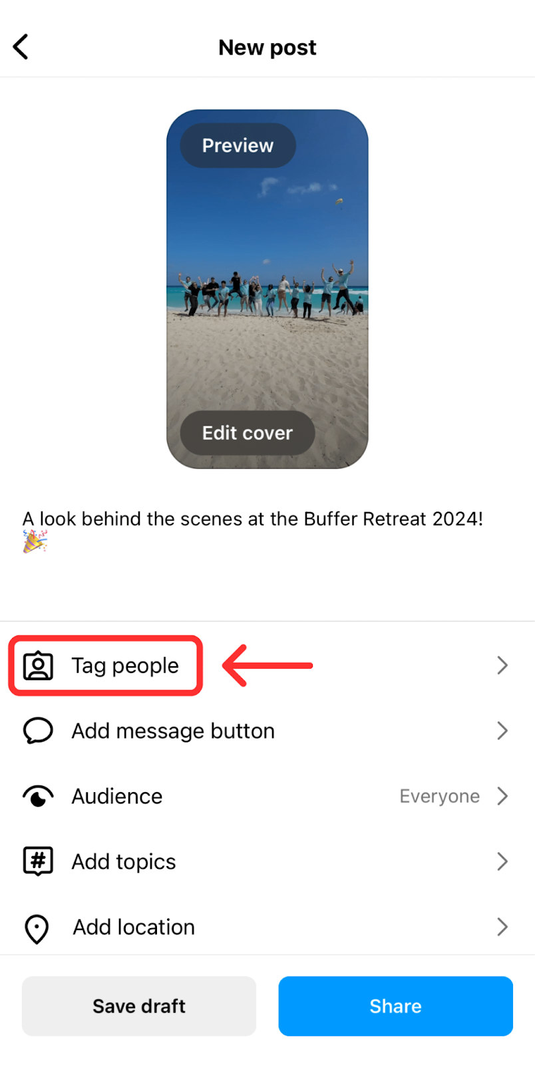

Maximize Cross-Promotion
TIPS
TOOLS
Collaborate with nearby AWS sections, industry partners, or local influencers to cross-promote events on each other’s pages.
  Example: Host a joint event or co-create content to share across platforms for wider visibility.
Tag and engage with local companies, schools, or venues associated with your event.
  Example: If your event is held at a local school or manufacturing facility, tag their social media pages in your post and comment on their event-related posts to strengthen collaboration.
Encourage partners to repost your content or share posts directly with their followers.
  Example: Use Instagram’s collaborator feature so posts appear on both your feeds for increased reach.
Use the @mention feature in captions or images to tag partner accounts.
On Instagram, make use of the collaborator feature so posts appear on both accounts once accepted.
Regularly engage with tagged partners' posts (like, share, or comment) to build rapport and encourage reciprocal promotion.

Slide 3
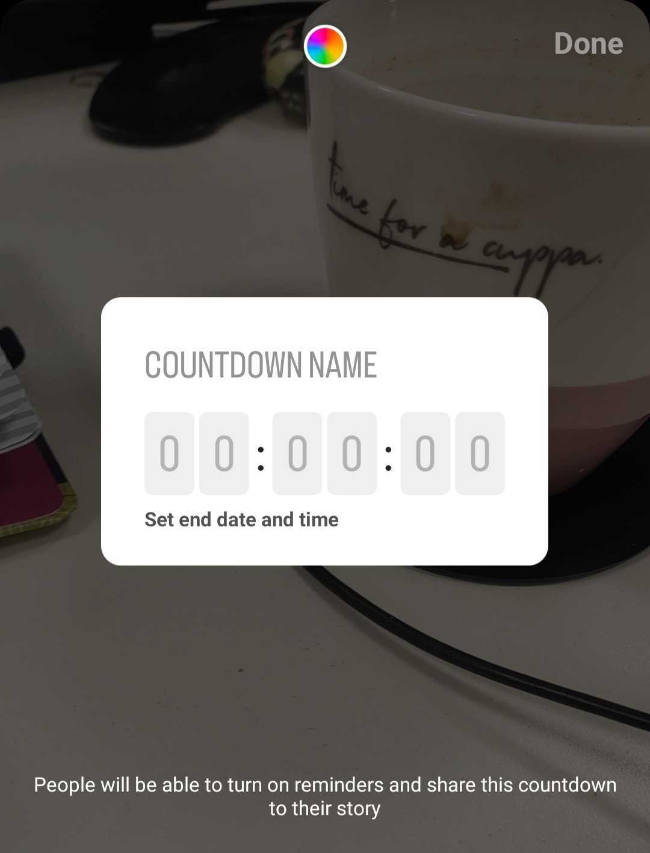
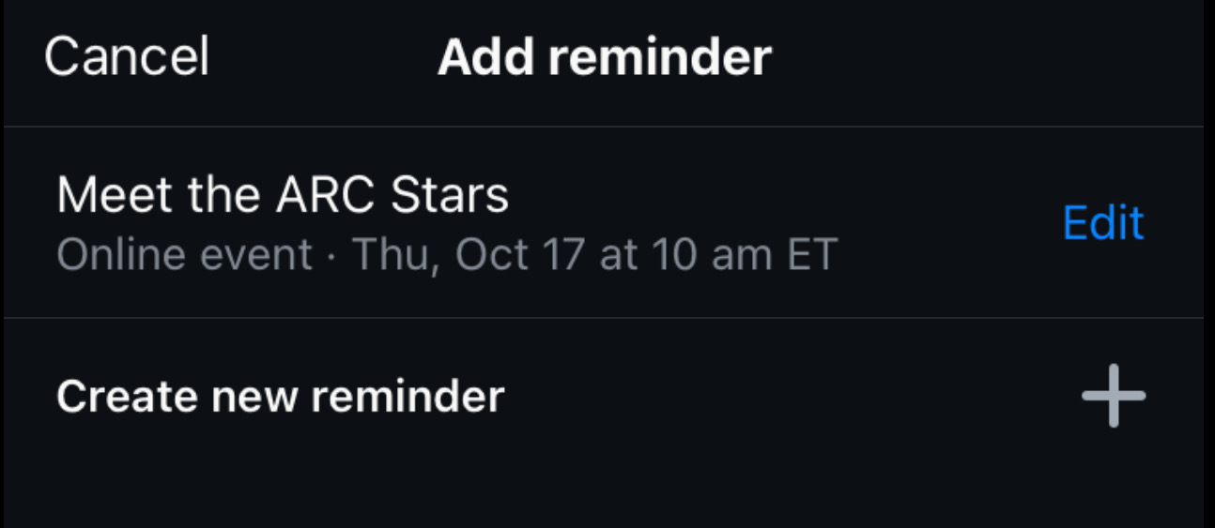
Incorporate Instagram Reels & Stories
TIPS
TOOLS
Use Instagram Reels to create engaging, short videos showcasing:
  Behind-the-scenes content: Event setup, speaker rehearsals, or volunteer highlights.
  Event teasers: Venue walkthroughs, key speakers, or sponsor highlights.
  Quick tutorials or tips: Share event-related skills or interesting welding techniques.
Leverage Stories to build excitement with:
  Countdown stickers, event polls, or interactive Q&A sessions.
  A "day-in-the-life" style story featuring members or staff preparing for the event.
  Reminders about registration deadlines or featured sessions.
Add captions or trending music to Reels to increase accessibility and appeal.
  Use tools like CapCut or Instagram’s built-in editor for polished videos.
Use the Countdown Sticker on Instagram Stories to create anticipation.
Post reminders directly from your mobile device and enable Event Reminders to notify followers.
Experiment with apps like Canva or CapCut to edit videos and add dynamic effects, ensuring professional-looking Reels.

Slide 4
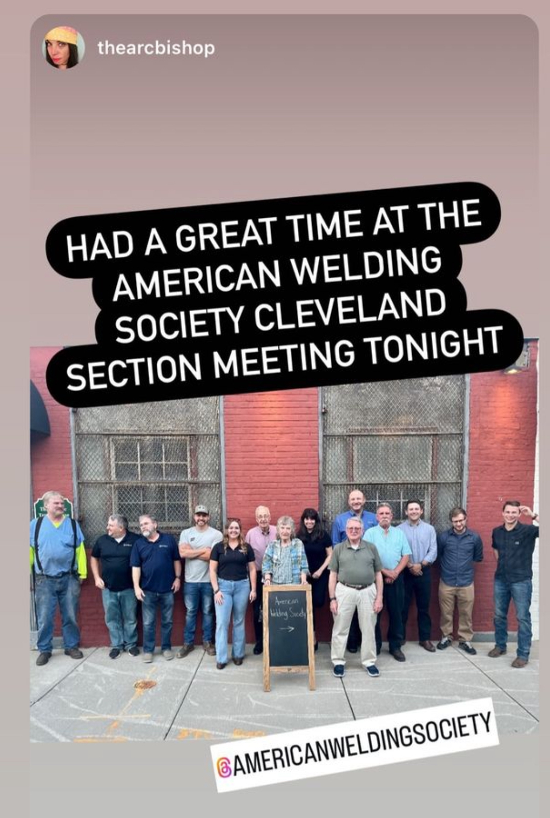

Leverage User-Generated Content
TIPS
TOOLS
Encourage attendees to share photos, videos, or testimonials during and after the event using a dedicated event hashtag (e.g., #AWSConference2025).
  Example: Host a photo or video contest where the best submission wins AWS merchandise or event discounts.
Highlight attendee contributions on your section’s feed:
  Repost tagged content to showcase the community’s engagement.
  Create a compilation of attendee posts for a post-event highlight reel.
Interact with user-generated content by liking, commenting, or sharing to build stronger community relationships.
Use the Repost App for Instagram or the Share Button on Facebook to feature attendee content easily.
Create a folder of tagged photos and videos to use for future promotional materials.
Add a call-to-action in your posts or during events encouraging attendees to tag your section and use the event hashtag.

Slide 5
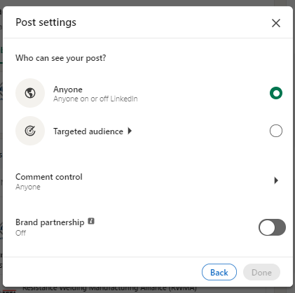
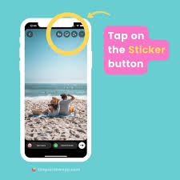
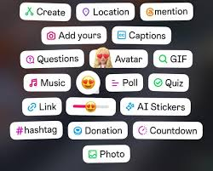
Use Organic Post Targeting
TIPS
TOOLS
Optimize your posts for relevant audiences by targeting based on:
  Location: Ensure your event promotions reach local attendees.
  Demographics: Tailor content to the age, gender, or interests of your target audience.
  Professional Attributes: Use LinkedIn’s targeting options to reach industry professionals for technical or professional events.
Incorporate location tags and stickers in Instagram Stories and posts to boost visibility for local audiences.
Experiment with organic post formats that resonate with specific groups:
  Event teasers: Highlight speakers or workshops that appeal to your audience.
  Community spotlights: Share success stories or testimonials to attract similar participants.
On Facebook and LinkedIn, use built-in targeting features for organic posts to reach specific demographics.
Utilize Instagram’s location tagging and stories with location stickers to increase local discoverability.
Monitor engagement metrics in platform analytics to refine future targeting strategies.

Slide 6
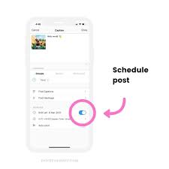
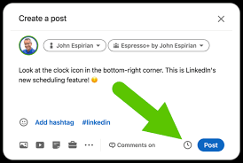
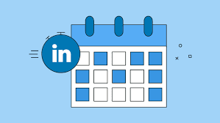
Streamline Event Promotion with Post Scheduling
TIPS
TOOLS
Plan and schedule content in advance to ensure consistent and timely event promotion.
  Pre-event: Create awareness with countdowns, speaker spotlights, and registration reminders.
  During the event: Share live updates, attendee highlights, and behind-the-scenes content.
  Post-event: Post recaps, testimonials, and thank-you messages to maintain engagement.
Batch-create content to save time and ensure visual and messaging consistency across platforms.
Use a content calendar to map out posts leading up to, during, and after the event.
Schedule posts at optimal times based on platform analytics to maximize reach and engagement.
Use scheduling platforms like Meta Business Suite, Hootsuite, or Buffer to automate posts.
Utilize native scheduling tools on Facebook, Instagram, and LinkedIn for ease of use.
Track your post-performance metrics to adjust your strategy for future events.

Slide 7
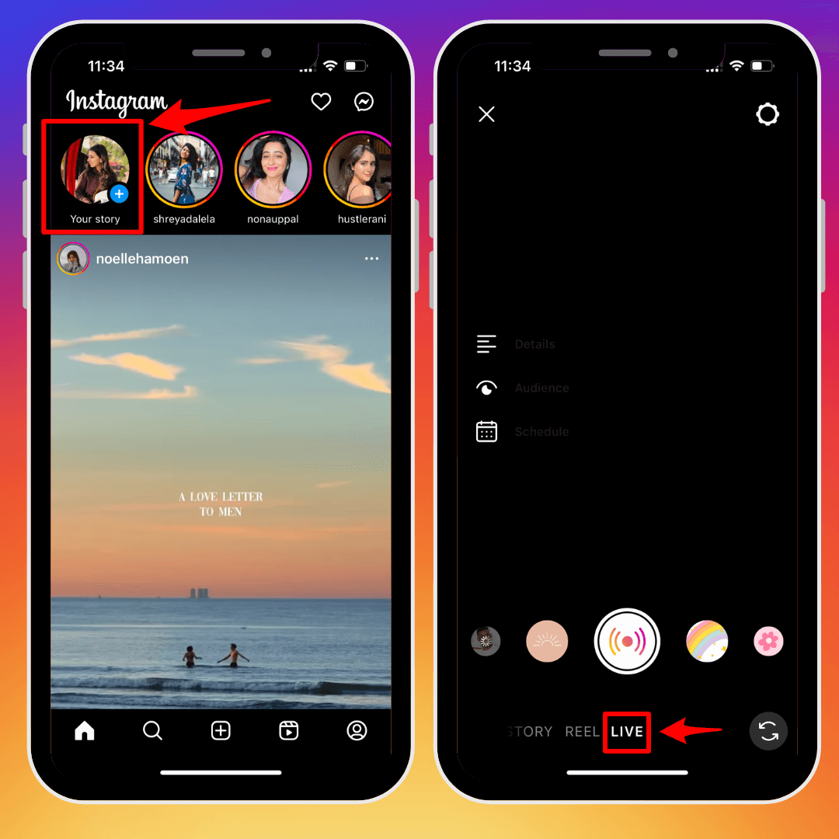
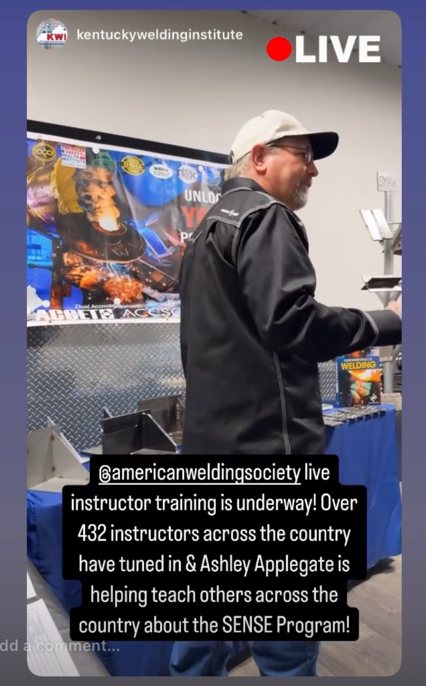
Use Live Features to Build Hype
TIPS
TOOLS
Use Facebook Live or Instagram Live to engage your audience with real-time content during key moments:
  Pre-event: Host live Q&A sessions with speakers or organizers to build anticipation.
  During the event: Stream sessions, keynote speeches, or on-the-ground highlights for those who can’t attend in person.
  Post-event: Share behind-the-scenes moments, thank attendees, or announce future events.
Encourage live interaction by inviting viewers to comment, ask questions, or participate in live polls during the stream.
Promote your live sessions in advance with countdowns and reminders to maximize attendance.
Use Facebook Live and Instagram Live for simple, built-in streaming options.
Save and repurpose live sessions as video content for later sharing or promotional use.

Slide 8
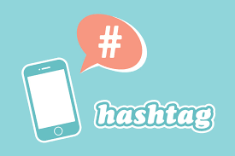
Create Event Hashtags
TIPS
TOOLS
Develop unique and consistent hashtags for all section events to unify posts and improve discoverability:
  Example: Use regional hashtags like #AWSMidwest2025 or event-specific ones like #AWSWeldingWorkshop.
Combine branded hashtags with trending or relevant industry hashtags to expand reach (e.g., #WeldingCommunity, #MetalFabrication).
Encourage attendees, partners, and sponsors to use the event hashtag in their posts for organic promotion.
Monitor your event hashtag to engage with attendee content by liking, commenting, or sharing posts.
Include your hashtags at the end of captions for posts, Reels, and Stories.
Use tools like Hashtagify or RiteTag to find trending hashtags related to your event topic.
Create a hashtag strategy template to ensure consistent usage across all platforms and events.

Slide 9
Frequently Asked Questions
How often should we post on social media to promote an event?
  Aim to post 2-3 times a week in the month leading up to the event. Mix up content types, including countdowns, speaker spotlights, testimonials, and behind-the-scenes content.
What’s the best platform to promote our section events?
  It depends on your target audience:
    Instagram: Great for reaching younger audiences with engaging visuals like Reels and Stories.
    Facebook: Effective for local community engagement and older demographics.
    LinkedIn: Ideal for professional development events and reaching industry professionals.
What are some good tools to design our social media graphics?
  Canva: A user-friendly tool with pre-made templates that align with AWS branding.
  Adobe Express: For creating polished visuals with advanced customization options.
  Refer to the AWS brand guidelines for design guidelines.
How should we follow up after an event?
  Post event recaps, share testimonials, or highlight key takeaways.
  Use post-event engagement as a lead-up for the next event by maintaining audience interest.
How can we measure the success of our social media efforts?
  Monitor engagement metrics such as likes, shares, comments, and follower growth.

Slide 10
THANK YOU

