Slide 1
LEADERSHIP SYMPOSIUM
Promoting Your Section on Social Media

Slide 2




Promoting Your Section on Social Media
Why Social Media Matters
  Helps grow your local welding community
  Reaches students, professionals, educators, and employers
  Increases attendance at events and awareness of Section opportunities
  Makes your Section more visible and active within AWS

Slide 3
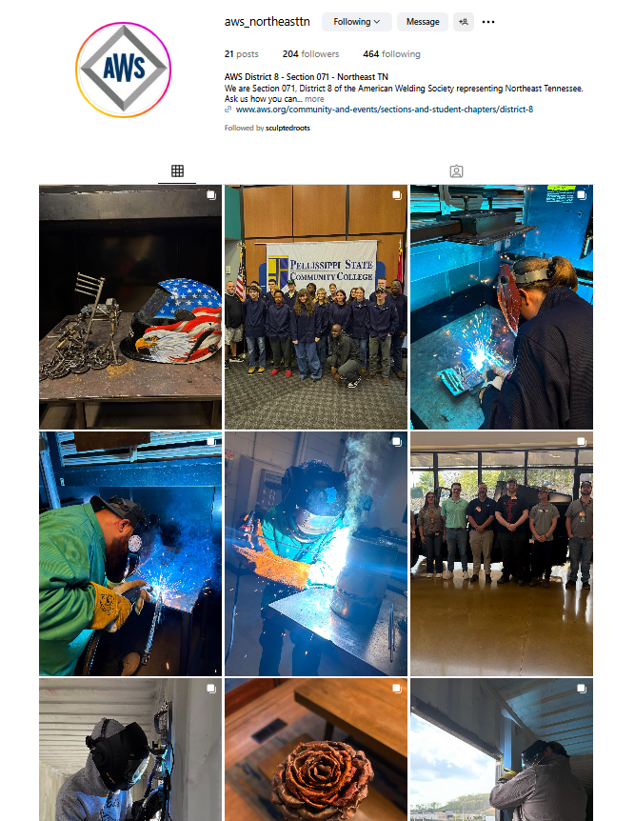
Promoting Your Section on Social Media
Getting Started
  Check if your Section already has a Facebook or Instagram account
  If you need help creating an account, contact social@aws.org
  Use a simple name: @AWS[SectionName] (e.g., @AWS_Chicago or AWS_Chicago_Section)
  Add a short bio and link to section website
  Use Section logo as profile image

Slide 4
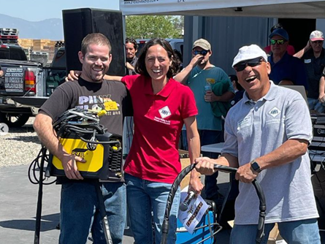
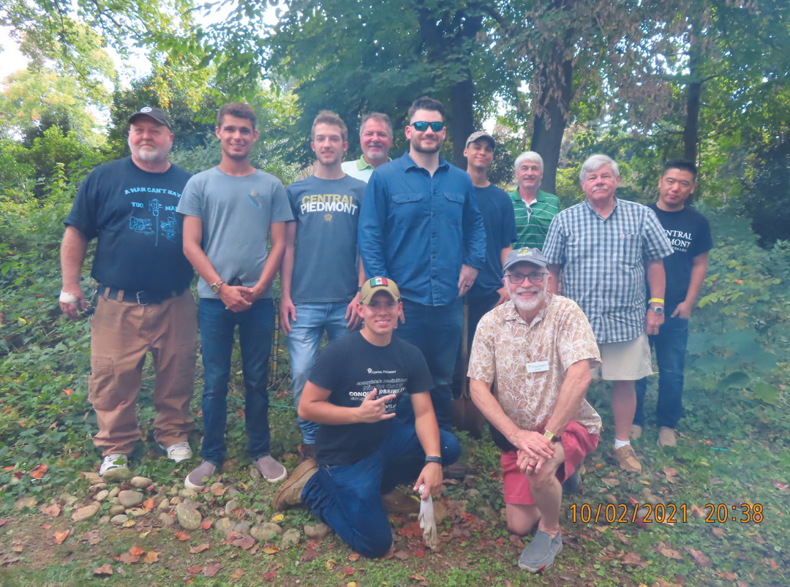
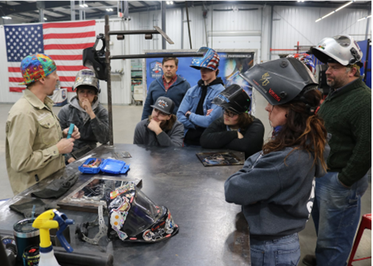

Promoting Your Section on Social Media
What to Post
  Upcoming events (flyers, reminders, countdowns)
  Event photos and thank-you recaps
  Member spotlights or volunteer highlights
  Scholarship or apprenticeship opportunities
  Welding tips, fun facts, or AWS news
  Share posts from AWS social media platforms and add your own commentary in the caption

Slide 5
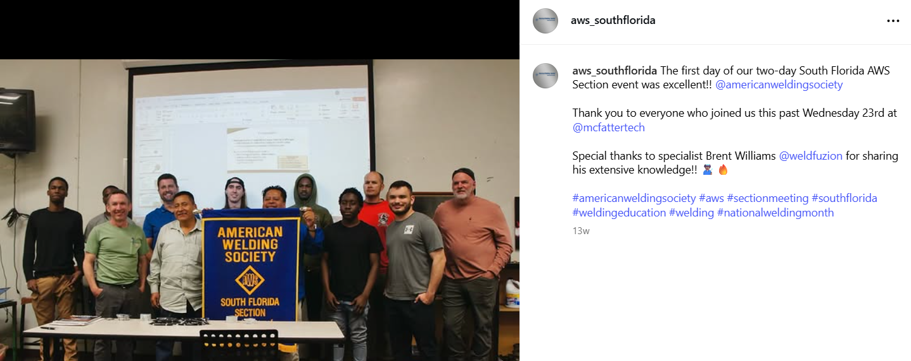
Promoting Your Section on Social Media
How to Post
  Use high-quality images or short videos
  Keep captions short and clear
  Include who, what, when, where
  Add 2–5 hashtags (e.g., #AWSsection #WeldingCommunity)
  Tag speakers, sponsors, schools, or venues when possible
  Tag @americanweldingsociety for added visibility

Slide 6
Promoting Your Section on Social Media
Posting Timeline
  4 weeks out: Save the date
  2 weeks out: Reminders or speaker spotlights
  1 week out: Countdown or RSVP reminder
  During: Photos, Reels, Stories
  After: Thank-you and photo recap

Slide 7
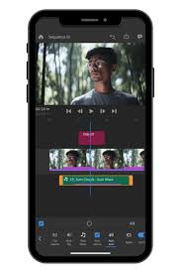


Promoting Your Section on Social Media
Helpful (Free) Tools
  Canva (reference Brand Guidelines in your Digital Toolkit)
  Facebook Content Calendar (schedule posts in advance)
  CapCut or Instagram Reels editor (for editing video clips)
  Repost app (to share tagged photos from attendees)

Slide 8
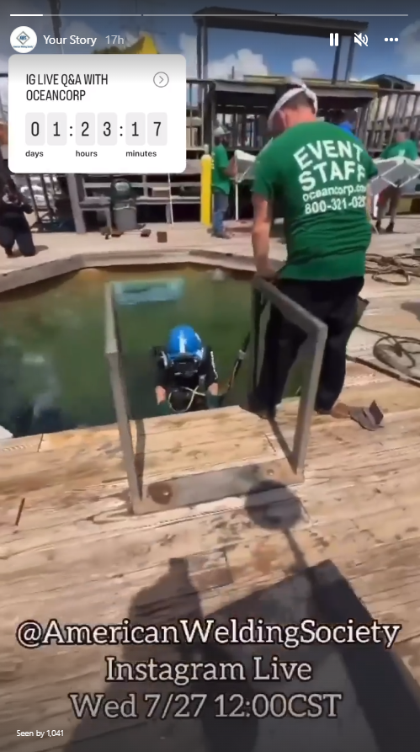
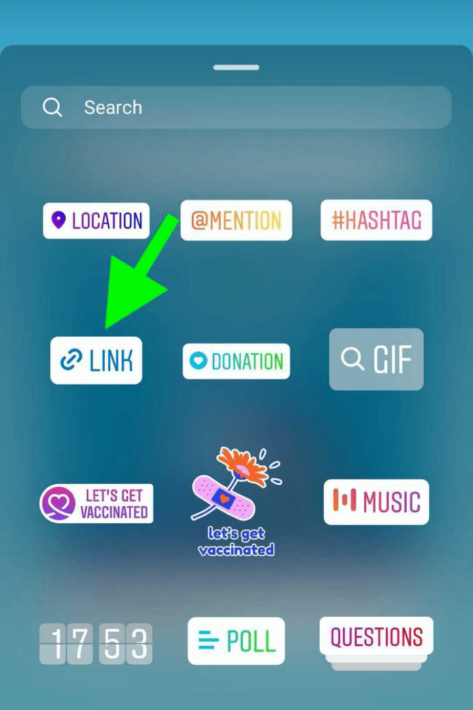
Promoting Your Section on Social Media
Instagram Tips
  Use Stories for quick updates and countdowns and to add links (cannot add links in Instagram captions)
  Use Reels for event videos, welding demos, behind the scenes, or interviews
  Use the Collaborator feature to post together with a partner or school

Slide 9
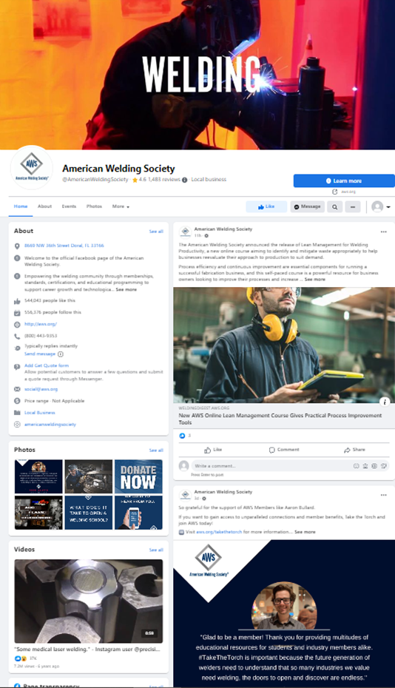
Promoting Your Section on Social Media
Facebook Tips
  Great for posting event details, links to register, and multiple photos
  Tagging local schools, companies, or speakers helps boost reach
  Use groups or events to invite people to attend
  Use event feature

Slide 10
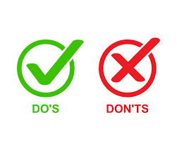
Promoting Your Section on Social Media
Social Media Do’s and Don’ts
DO:
  ✓ Tag partners, speakers, and venues
  ✓ Ask questions in caption to encourage comments
  ✓ Include who/what/where/when
DON’T:
  ✗ Use copyrighted music or unapproved logos
  ✗ Share personal or political content
  ✗ Ignore complaints – reply or forward concerns to social@aws.org

Slide 11

Promoting Your Section on Social Media
Need help?
  We’re here to support you!
  Email social@aws.org for help writing posts, getting account access, or using tools
  Check the Best Practices Social Media Guide and Promotional Calendar, available in your Digital Toolkit, for content ideas and guidelines.

Slide 12
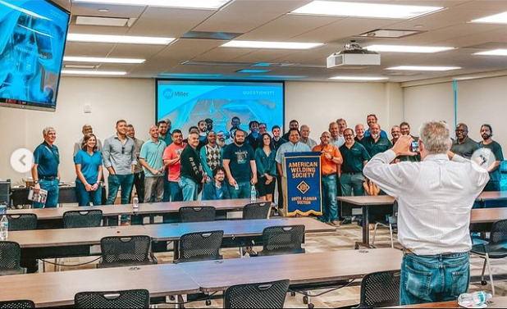
Promoting Your Section on Social Media
Let’s Get Started
  Start small: Share 1 post a week
  Use photos from your events and tag AWS
  You’re the voice of your welding community—help us grow it!

Slide 13
THANK YOU

